Slide 1

Bounded Suboptimal N-Player Game Tree Search
Advisor: Dor Atzmon
Asi Zaks, Shachar Meretz, Peleg Biton, Omer Nagar
Field : Artificial Intelligence
Notes:
חיפוש תת אופטימלי מוגבל בעץ משחק מרובה שחקנים

Slide 2





















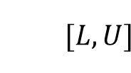


Previous Work
 | Optimal |  | Bounded Suboptimal
 | Naïve | Pruning
2-Player
N-Player |  |  | ?
$$6$$
$$6$$
$$α=6$$
$$n$$
$$β=∞$$
$$[L,U]$$
$$α, β$$
$$6$$
$$5$$
$$α=6$$
$$6$$
$$5$$
$$β=5$$
Our Goal:
Show how and in which conditions
bounded suboptimal solution for N-Player game
can be achieved.
$$5$$
$$10$$
$$5$$
?
ɛ = 3
$$\text{2 }\text{, }\text{3 }\text{, }\text{1}$$
$$≥\text{6} \text{, }≤\text{4} \text{, }≤\text{4}$$
?
$$1 , 2 , 3$$
$$\text{2 }\text{, }\text{3 }\text{, }\text{1}$$
$$6 , 3, 1$$
$$≤\text{5} \text{,}≥\text{5} \text{,}≥\text{5}$$
2 , 3 , 1
3 , 1 , 2
4 , 5 , 1
3 , 1 , 2
3 , 2 , 1
$$maxsum=10$$
Notes:
Minimax maxn

Slide 3

Motivation
It is not feasible to browse the entire tree
↓
Time limit the search
↓
Prune and search only relevant parts
↓
Still much left
↓
Optimal is better?
Deeper is better!
Prune
Notes:
לא פיזיבילי לפתח את כל העץ
באמצעות גיזום נפתח יותר לעומק
באמצעות גיזום תת-אופטימלי נעמיק אפילו יותר

Slide 4
N-Player Bounded Sub-optimal Algorithm *game manager game players – strategies player playturn(state, game)
BoundedPruning(Node, Player, Bound, Promised)
IF Node is terminal, RETURN static value
Bbest = BoundedPruning(first Child, next Player, Sum, Promised)
FOR each remaining Child
IF Node is root, Promised = Max{Promised, Bbest[Player]}
// Bounded sub-optimal root immediate pruning
IF Node is root AND Promised + ɛ ≥ Sum, RETURN Bbest
// Bounded sub-optimal inner shallow pruning & return vector of zeros
IF Player is Player2 AND Promised + ɛ ≥ Sum – Bbest[Player], RETURN [0] * NumPlayers
// Optimal immediate & shallow pruning
IF Bbest[Player] > = Bound, RETURN Bbest
Current = BoundedPruning(Child, next Player, Sum - Bbest[Player], Promised)
IF Current[Player] > Bbest[Player], Bbest = Current
RETURN Bbest
1
7 , 2 , 3
2
7 , 2 , 3
6 , 5 , 1
3
6 , 5 , 1
9 , 1 , 2
Notes:
כל קומה בעץ מייצגת תור של שחקן
עלים בעץ מייצגים מצבים סופיים במשחק
כך שכל וקטור מייצג את הניקוד לאותו מצב סופי
וכל כניסה בוקטור מייצגת ניקוד של שחקן

Slide 5
ɛ = 3
Promised = 0
Sum = 12
Player = Player1
3-Players Sub-Optimal Pruning
1
2
4 , 5 , 3
10 , 1 , 1
11 , 0 , 1
3
1 , 2 , 9
1
8 , 4 , 0
2
4 , 1 , 7
3
3 , 5 , 4
5 , 6 , 1

Slide 6
ɛ = 3
Promised = 0
Sum = 12
Player = Player1
3-Players Sub-Optimal Pruning
1
2
4 , 5 , 3
10 , 1 , 1
11 , 0 , 1
3
1 , 2 , 9
1
8 , 4 , 0
2
4 , 1 , 7
3
3 , 5 , 4
5 , 6 , 1
Notes:
לפניכם עץ משחק של שלושה שחקנים
את החיפוש נתחיל בשורש העץ
לטובת גיזום קודקודים נגדיר את ערכי המשתנים הבאים

Slide 7
ɛ = 3
Promised = 0
Sum = 12
Player = Player2
3-Players Sub-Optimal Pruning
1
2
4 , 5 , 3
10 , 1 , 1
11 , 0 , 1
3
1 , 2 , 9
1
8 , 4 , 0
2
4 , 1 , 7
3
3 , 5 , 4
5 , 6 , 1

Slide 8
ɛ = 3
Promised = 4
Sum = 12
Player = Player1
3-Players Sub-Optimal Pruning
1
4 , 5 , 3
2
4 , 5 , 3
10 , 1 , 1
11 , 0 , 1
3
1 , 2 , 9
1
Promised= 0
Bbest[Player1]= 4
8 , 4 , 0
2
Update Promised
4 , 1 , 7
3
3 , 5 , 4
5 , 6 , 1

Slide 9
ɛ = 3
Promised = 4
Sum = 12
Player = Player2
3-Players Sub-Optimal Pruning
1
4 , 5 , 3
2
4 , 5 , 3
10 , 1 , 1
11 , 0 , 1
3
1 , 2 , 9
1
8 , 4 , 0
2
4 , 1 , 7
3
3 , 5 , 4
5 , 6 , 1

Slide 10
ɛ = 3
Promised = 4
Sum = 12
Player = Player3
3-Players Sub-Optimal Pruning
1
4 , 5 , 3
2
4 , 5 , 3
10 , 1 , 1
11 , 0 , 1
3
1 , 2 , 9
1
8 , 4 , 0
2
4 , 1 , 7
3
3 , 5 , 4
5 , 6 , 1

Slide 11
ɛ = 3
Promised = 4
Sum = 12
Player = Player2
3-Players Sub-Optimal Pruning
1
4 , 5 , 3
2
4 , 5 , 3
1 , 2 , 9
10 , 1 , 1
11 , 0 , 1
3
1 , 2 , 9
1
8 , 4 , 0
2
4 , 1 , 7
3
3 , 5 , 4
5 , 6 , 1

Slide 12
ɛ = 3
Promised = 4
Sum = 12
Player = Player3
3-Players Sub-Optimal Pruning
1
4 , 5 , 3
2
4 , 5 , 3
1 , 2 , 9
10 , 1 , 1
11 , 0 , 1
3
1 , 2 , 9
1
8 , 4 , 0
2
4 , 1 , 7
3
3 , 5 , 4
5 , 6 , 1

Slide 13
ɛ = 3
Promised = 4
Sum = 12
Player = Player1
3-Players Sub-Optimal Pruning
1
4 , 5 , 3
2
4 , 5 , 3
1 , 2 , 9
10 , 1 , 1
11 , 0 , 1
3
1 , 2 , 9
1
8 , 4 , 0
2
4 , 1 , 7
3
3 , 5 , 4
5 , 6 , 1

Slide 14
ɛ = 3
Promised = 4
Sum = 12
Player = Player2
3-Players Sub-Optimal Pruning
1
4 , 5 , 3
2
4 , 5 , 3
1 , 2 , 9
10 , 1 , 1
11 , 0 , 1
3
1 , 2 , 9
1
8 , 4 , 0
2
4 , 1 , 7
3
3 , 5 , 4
5 , 6 , 1

Slide 15
ɛ = 3
Promised = 4
Sum = 12
Player = Player1
3-Players Sub-Optimal Pruning
1
4 , 5 , 3
2
4 , 5 , 3
1 , 2 , 9
10 , 1 , 1
11 , 0 , 1
3
1 , 2 , 9
1
4 , 1 , 7
8 , 4 , 0
2
4 , 1 , 7
3
3 , 5 , 4
5 , 6 , 1

Slide 16
ɛ = 3
Promised = 4
Sum = 12
Player = Player2
3-Players Sub-Optimal Pruning
1
4 , 5 , 3
2
4 , 5 , 3
1 , 2 , 9
10 , 1 , 1
11 , 0 , 1
3
1 , 2 , 9
1
4 , 1 , 7
8 , 4 , 0
2
4 , 1 , 7
3
3 , 5 , 4
5 , 6 , 1

Slide 17
ɛ = 3
Promised = 4
Sum = 12
Player = Player3
3-Players Sub-Optimal Pruning
1
4 , 5 , 3
2
4 , 5 , 3
1 , 2 , 9
10 , 1 , 1
11 , 0 , 1
3
1 , 2 , 9
1
4 , 1 , 7
8 , 4 , 0
2
4 , 1 , 7
3
3 , 5 , 4
5 , 6 , 1

Slide 18
ɛ = 3
Promised = 4
Sum = 12
Player = Player2
3-Players Sub-Optimal Pruning
1
4 , 5 , 3
2
4 , 5 , 3
1 , 2 , 9
10 , 1 , 1
11 , 0 , 1
3
1 , 2 , 9
Player is Player2
Promised = 4
Bbest[Player2]= 5
1
4 , 1 , 7
8 , 4 , 0
2
Promised + ɛ = 4 + 3 ≥ 12 – 5 = Sum – Bbest[Player2]
4 , 1 , 7
3 , 5 , 4
3
Prune !
3 , 5 , 4
5 , 6 , 1

Slide 19
ɛ = 3
Promised = 4
Local player 1 = 8
Sum = 12
Player = Player1
3-Players Sub-Optimal Pruning
1
4 , 5 , 3
2
4 , 5 , 3
1 , 2 , 9
10 , 1 , 1
11 , 0 , 1
3
1 , 2 , 9
Player is Player2
Promised = 4
Bbest[Player2]= 5
1
4 , 1 , 7
0 , 0 , 0
8 , 4 , 0
2
Promised + ɛ = 4 + 3 ≥ 12 – 5 = Sum – Bbest[Player2]
4 , 1 , 7
3 , 5 , 4
Shallow
3
Prune !
3 , 5 , 4
5 , 6 , 1

Slide 20
ɛ = 3
Promised = 4
Sum = 12
Player = Player3
3-Players Sub-Optimal Pruning
1
4 , 5 , 3
2
4 , 5 , 3
1 , 2 , 9
10 , 1 , 1
11 , 0 , 1
3
1 , 2 , 9
4 , 1 , 7
1
4 , 1 , 7
0 , 0 , 0
8 , 4 , 0
2
4 , 1 , 7
3 , 5 , 4
3
3 , 5 , 4
5 , 6 , 1

Slide 21
ɛ = 3
Promised = 4
Sum = 12
Player = Player1
3-Players Sub-Optimal Pruning
1
4 , 5 , 3
2
4 , 5 , 3
1 , 2 , 9
10 , 1 , 1
11 , 0 , 1
3
1 , 2 , 9
4 , 1 , 7
1
4 , 1 , 7
0 , 0 , 0
8 , 4 , 0
2
4 , 1 , 7
3 , 5 , 4
3
3 , 5 , 4
5 , 6 , 1

Slide 22
ɛ = 3
Promised = 4
Sum = 12
Player = Player3
3-Players Sub-Optimal Pruning
1
4 , 5 , 3
2
4 , 5 , 3
1 , 2 , 9
10 , 1 , 1
11 , 0 , 1
3
1 , 2 , 9
4 , 1 , 7
1
4 , 1 , 7
0 , 0 , 0
8 , 4 , 0
2
4 , 1 , 7
3 , 5 , 4
3
3 , 5 , 4
5 , 6 , 1

Slide 23
ɛ = 3
Promised = 4
Sum = 12
Player = Player2
3-Players Sub-Optimal Pruning
1
4 , 5 , 3
2
4 , 5 , 3
1 , 2 , 9
10 , 1 , 1
11 , 0 , 1
3
1 , 2 , 9
4 , 1 , 7
1
4 , 1 , 7
0 , 0 , 0
8 , 4 , 0
2
4 , 1 , 7
3 , 5 , 4
3
3 , 5 , 4
5 , 6 , 1

Slide 24
ɛ = 3
Promised = 4
Sum = 12
Player = Player1
3-Players Sub-Optimal Pruning
1
4 , 5 , 3
2
4 , 5 , 3
1 , 2 , 9
10 , 1 , 1
11 , 0 , 1
3
1 , 2 , 9
4 , 1 , 7
1
4 , 1 , 7
0 , 0 , 0
8 , 4 , 0
2
4 , 1 , 7
3 , 5 , 4
3
3 , 5 , 4
5 , 6 , 1

Slide 25
ɛ = 3
Promised = 4
Sum = 12
Player = Player2
3-Players Sub-Optimal Pruning
1
4 , 5 , 3
2
4 , 5 , 3
1 , 2 , 9
10 , 1 , 1
11 , 0 , 1
3
1 , 2 , 9
4 , 1 , 7
1
4 , 1 , 7
0 , 0 , 0
8 , 4 , 0
2
4 , 1 , 7
3 , 5 , 4
3
3 , 5 , 4
5 , 6 , 1

Slide 26
ɛ = 3
Promised = 10
Sum = 12
Player = Player1
3-Players Sub-Optimal Pruning
1
10 , 1 , 1
2
4 , 5 , 3
1 , 2 , 9
10 , 1 , 1
11 , 0 , 1
3
1 , 2 , 9
4 , 1 , 7
1
Promised= 4
Bbest[Player1]= 10
4 , 1 , 7
0 , 0 , 0
8 , 4 , 0
2
Update Promised
4 , 1 , 7
3 , 5 , 4
3
3 , 5 , 4
5 , 6 , 1

Slide 27
ɛ = 3
Promised = 10
Sum = 12
Player = Player1
3-Players Sub-Optimal Pruning
1
10 , 1 , 1
Immediate
2
4 , 5 , 3
1 , 2 , 9
10 , 1 , 1
11 , 0 , 1
3
1 , 2 , 9
4 , 1 , 7
Promised = 10
ɛ = 3
1
4 , 1 , 7
0 , 0 , 0
8 , 4 , 0
2
Promised + ɛ = 10 + 3 ≥ 12 = Sum
4 , 1 , 7
3 , 5 , 4
3
Prune !
3 , 5 , 4
5 , 6 , 1

Slide 28
ɛ = 3
Promised = 10
Sum = 12
Player = Player1
3-Players Sub-Optimal Pruning
1
10 , 1 , 1
2
Root Player Value = 10
ɛ = 3
Root Player Optimal Value = 11
*Looking on the sub tree of the root with only the 2 leftmost children, the ‘Root Player Optimal Value’ is 5 and ‘BoundedPruning Root Player Value’ is 4
4 , 5 , 3
1 , 2 , 9
10 , 1 , 1
11 , 0 , 1
3
1 , 2 , 9
4 , 1 , 7
Success!
1
4 , 1 , 7
0 , 0 , 0
8 , 4 , 0
2
4 , 1 , 7
3 , 5 , 4
3
3 , 5 , 4
5 , 6 , 1

Slide 29
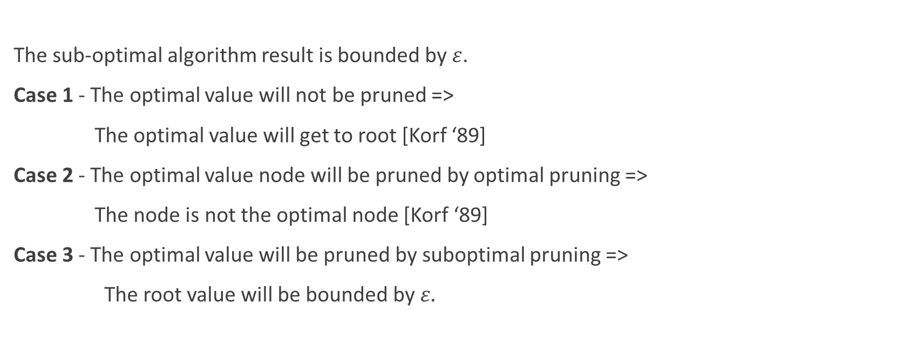
Proof summary
The sub-optimal algorithm result is bounded by $ε$.
Case 1 - The optimal value will not be pruned =>
The optimal value will get to root [Korf ‘89]
Case 2 - The optimal value node will be pruned by optimal pruning =>
The node is not the optimal node [Korf ‘89]
Case 3 - The optimal value will be pruned by suboptimal pruning =>
The root value will be bounded by $ε.$

Slide 30
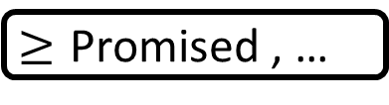
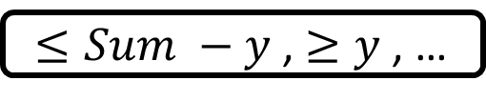
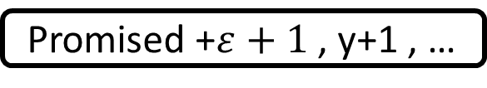
Shallow pruning
Promised
Root
Bbest[Player2]= y
Promised + ɛ ≥ Sum – y
1
$≥\text{Promised}$ , …
2
Promised , …
. . .
Promised + ɛ ≥ Sum – Bbest[Player2]
1
… , … , ...
Prune !
2
… , … , …
$≤Sum −y$ , $≥y$ , …
3
… , y , …
Optimal node
Promised +$ε+1$ , y+1 , …

Slide 31
Shallow pruning
Promised
Root
Promised + ɛ ≥ Sum – y
1
$≥\text{Promised}$ , …
Promised + ɛ + y ≥ Sum
2
Promised , …
. . .
Promised + ɛ + 1 + y + 1> Promised + ɛ + y ≥ Sum
1
… , … , ...
Promised + ɛ + 1 + y + 1≥ Sum
2
… , … , …
$≤Sum −y$ , $≥y$ , …
3
… , y , …
Optimal node
Promised +$ε+1$ , y+1 , …

Slide 32
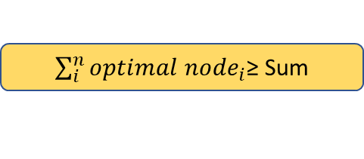
Shallow pruning
Promised
Root
$\sum_{i}^{n}{{optimal node}_{i}}$≥ Sum
1
$≥\text{Promised}$ , …
2
Contradiction !
Promised , …
. . .
1
Root value still bounded by 𝜀 !
… , … , ...
0 , 0 , 0
2
… , … , …
$≤Sum −y$ , $≥y$ , …
3
… , y , …
Optimal node
Promised +$ε+1$ , y+1 , …

Slide 33
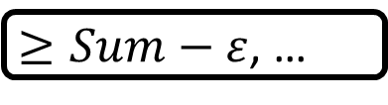
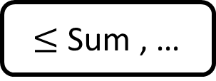
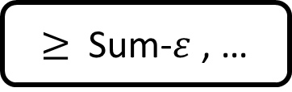
Immediate pruning
Promised
Root
1
Promised ≥ Sum - ɛ
$≥Sum−ε$, …
2
Promised + ɛ ≥ Sum
$≥$ Sum-$ε$ , …
$≤$ Sum , …
Prune !
. . .
. . .

Slide 34
Project GitHub Link
https://github.com/omernag/Bounded-Suboptimal-N-Player-Game-Tree-Search
Hackathon folder name: Hackathon - Current Algorithm

Slide 35
Thanks!

